Slide 1
Programming Paradigms[mainly in .NET]
(Refresher)

Slide 2
OOP Principles Basics
Encapsulation
Abstraction
Inheritance
Polymorphism
Coupling & Cohesion
Association vs Aggregation vs Composition
Check in google once -
Diamond Problem
virtual & new in C#
For Further Exploration -
Software Principles Post | LinkedIn

Slide 3
FP Basics
In Imperative & Object Oriented programming you pass data to function but in FP(Functional Programming) you apply some function to data
Normal Programming Example
a.method(someData)
FP (Linq based) Example
SomeList.Where(x => x.SomePredicate == true)

Slide 4
FP Basics - Core Principles
Avoid Side Effects
Use Pure Function
Avoid Shared State
Avoid Mutations
Use Function Composition
Use Declarative Code Instead of Imperative Code

Slide 5
FP Basics – Side Effects
Side Effect Example -
let x = 1;
func1();
console.log(x);
func2();
console.log(x);
What’s the guarantee that x has not changed?

Slide 6
FP Basics – Side Effects
No Side Effect Example -
const x = 5;
let z = func(num){
let y = 3;
return num * x * y++;
}

Slide 7
FP Basics – Side Effects
Side Effects Caused By –
If a function changes some external data or input argument that’s outside of its scope. Its okay if the function changes some data within it’s scope (just like variable y in earlier slide – that’s not a side effect)
Throwing an Exception
Invoking functions that have a side effect
Triggering an external process

Slide 8
FP Basics – Pure Function
Conditions for a function to be a pure function –
No side effects – FP cannot totally avoid side effects(since sometimes that’s inevitable) but it can minimize that
Idempotent – returns every time the same value for same inputs

Slide 9
FP Basics – Closure
Mainly implemented using callbacks
Example -
var a=10, b = 2;
var func = function(){
console.log(a+b);
};
setTimeout(func, 2000);
a = 20, b = 5;
Although this func gets invoked immediately & then setTimeout invokes func after 2 secs but still func has access to new a & b values.
In .NET, Closures are also known as Captured Variables

Slide 10
FP Basics – Shared State
Mainly state is shared via -
Global Scope
Closures
As per FP, state should not be shared but rather passed between functions & use state clone to work on functions internally

Slide 11
FP Basics – Immutability
Diff. between String & StringBuilder in .NET?
Probably everyone knows the answer(that being a common interview question)
But how do you make a custom immutable class in .NET(or any other language)

Slide 12
FP Basics – Immutability
Allow the state of the object to be changed only during construction(& not via any other means e.g. a public setter) & use getters to get the current state of the object
Immutable Class Example –
public class ImmutableClass{
public SomeType _someData;
public ImmutableClass(SomeType someData){
_someData = someData;
}
public SomeType SomeData { get { return _someData; } }
}

Slide 13
FP Basics – Immutability
Immutability in C# using Record Type
Immutability, Record types and with keyword in C# | LinkedIn
A great advantage of Immutable Classes –
Inherently Thread Safe
ReadOnly vs Immutable Collections –
c# - Why use ImmutableList over ReadOnlyCollection? - Stack Overflow
Eric Lippert’s Immutability Series –
Immutability | Fabulous adventures in coding | Page 2

Slide 14
FP Basics – Advantages
Main Advantages of FP –
Inherently Thread Safe
Declarative Style of Programming which increases readability

Slide 15
FP Basics – Higher Order Function
A function in FP is a higher order function if -
1) You pass some other function to the function
2) You return some other function from the function
3) Both 1 & 2 above
Example
Action<T2> SomeMethod(Action<T1> action)

Slide 16
FP Basics – Higher Order Function
A more practical Example –
Exception Handling using Higher Order Functions –
void HandleException(Action<T> action, T t){
try{
action(t);
}
catch(Exception ex){
logger.log(ex.ToString());
}
}

Slide 17
FP Basics – Currying & Partial Application
Arity – Number of parameters passed to a function
Currying – Reduce arity from a higher to lower value function
Example –
function add(a){
return function(b){
return a + b;
}
}
add(a)(b);
Basically, currying tries to produce nested unary(1-ary) functions.

Slide 18
FP Basics – Currying & Partial Application
Partial Application –
Some parameters are actual values while others remain as variables
Example
div(x,y) = x/y
div1(y) = div(1,y) = 1/y;
Basically, Partial application tends to produce functions that have an arbitrary number of arguments & the transformed functions usually have a lot of differences from the original one.

Slide 19
FP Basics – Currying & Partial Application
A more practical example –
DDD-Based-Enterprise-Application-Framework/Infrastructure/Concurrency/Synchronization/SharedDataProtection/BaseLocking.cs at master · sandipray63in/DDD-Based-Enterprise-Application-Framework · GitHub

Slide 20
FP Basics – Recursion
A practical example –
Memoization, a useful pattern for quick optimization - Event-Driven.io

Slide 21
FP Advanced
References –
What's the best way to balance functional programming design trade-offs?
Functors and Monads in C#
Dixin's Blog - Category Theory via C# (2) Monoid
Functional-Programming/haskell/Functional_Programming_Concepts.org at master · caiorss/Functional-Programming · GitHub
Functional Programming Design Patterns | F# for fun and profit

Slide 22
Const & Readonly
Const –
A const once initialized cannot be changed
ReadOnly–
It can be set only in 2 places –
1) While declaration at class level for initialization
2) Within a constructor

Slide 23
Static
A static class doesn’t need to be instantiated & the methods and properties can be accessed via the Class name only
Also, if a static variable is changed at some place then that change gets reflected across all the other places wherever it is used
But static variables can cause Threading & Memory issues
Also, What’s the relation between static variables & AppDomain in .NET?

Slide 24
Static (& AppDomain)
Static variables are per AppDomain in .NET
But then what’s an AppDomain?
An AppDomain basically provides an isolated region in which code runs inside of a process
What are the use cases where we might need to create our own AppDomain?

Slide 25
Static (& AppDomain)
Some custom AppDomain Use Cases –
Once a dll is loaded in default/main AppDomain, it cannot be unloaded. But if you create your own AppDomain and load a dll in it, you can unload the dll from it if needed.
Another example – Port Scanner
Requirement – There are N number of ports and each needs to be scanned in an isolated & secured region/boundary.
Sandboxed AppDomain for Partially Trusted Code –
c# - Loading Assembly in sandbox Appdomain - SecurityException - Stack Overflow
4) Loading multiple versions of same dll using multiple AppDomains

Slide 26
Static Constructor
Main usage –
To initialize something at the start-up of an application relevant to that class.

Slide 27
Private Constructor
Private constructor –
used when you don’t want to allow the user of the class to create the instance
But then how to get an instance of the class from outside the class?
Create the instance within the same class and get the instance using some static property or method
Example
public class SomeClass(){
private SomeClass(){}
public static SomeClass GetSomeClassInstance(){
return new SomeClass();
}}

Slide 28
Private Classes
Main Usage is in Nested Classes
Example –
public class OuterClass{
public OuterClass(){
InnerClass ic = new InnerClass{Name=“abc”, Email=“x@y.com”};
}
private class InnerClass{
public string Name{get;set;}
public string Email{get;set;}
}
}
But after introduction of Tuples in .NET, Tuples are more cleaner way to handle such stuffs instead of private class. But only problem is Tuples are immutable & if you need a mutable private class then Tuples will not work.

Slide 29
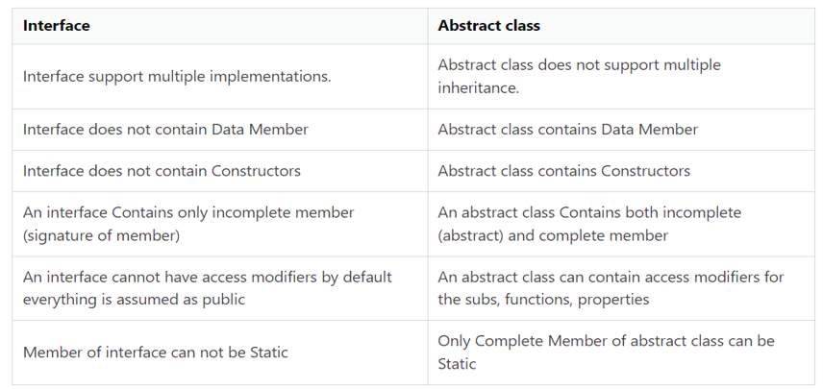
Interface and Abstract Class

Slide 30
Interface and Abstract Class
Design Goals –
Interface – Has-A relationship
Abstract Class – Is-A relationship
If you envision that there can be multiple base abstractions, start with an interface & then have the base abstractions as Abstract Classes & the concrete classes inherit and override the base Abstract class(es) methods.
Also google/chatGPT for implementing an interface implicitly/explicitly in .NET.
A practical Example –
DDD-Based-Enterprise-Application-Framework/Repository/UnitOfWork/IUnitOfWork.cs at master · sandipray63in/DDD-Based-Enterprise-Application-Framework · GitHub

Slide 31
Generics
Generics came into being –
To solve boxing/unboxing performance issue
To support multiple types for the same class or interface
A practical Example –
DDD-Based-Enterprise-Application-Framework/Repository/Base/BaseUnitOfWorkRepository.cs at master · sandipray63in/DDD-Based-Enterprise-Application-Framework · GitHub

Slide 32
Delegates – Predicate/ Action / Func
C Function pointers are not type-safe but C# Delegates are type safe function pointers
Multicast Delegates & Events Example –
public delegate int MyNewEventType(string param);
public event MyNewEventType MyNewEvent;
MyNewEvent += (string param) => { MessageBox.Show("Goodbye " + param); return 2; }
But Why does Multicast Delegates have “+=” or “-=” operations and not “=” operation?

Slide 33
Serialization
Binary –
Recommended for same language (e.g. .NET <-> .NET ) interoperability, being the fastest serialization technique for communication between same languages projects
Json & XML –
Recommended for cross language interoperability(e.g. .NET <-> Java).Nowadays Json is the default serialization technique for cross language interoperability but some legacy apps use xml for the same.
Custom –
Need to implement ISerializable interface
Some legacy apps have custom Serialization implemernted

Slide 34
Serialization
Some not-so-common Serialization Applications–
Cloning(/Prototype Pattern) –
c# - How do you do a deep copy of an object in .NET? - Stack Overflow
Comparing Deeply Nested Objects Values
This is only for detecting if there is some difference and not for finding the actual property values which have the difference. For that, use the Visitor Pattern instead.
By the way, Hashing also can be used to compare 2 objects to detect they are exactly similar or not but will have to build a custom hash to compare deeply nested objects.

Slide 35
Marker Interface
A marker interface is an empty interface with no methods within it.
Example –
public interface IMarker{}
public class Marker : IMarker{//Do Something}
But what’s the use of such an interface?
Assign some Metadata tag to the class
You can use this to put a type constraint.
Mainly used in DTOs & sometimes used in classes having methods.
Examples –
IList<IMarker> markersList = new List<IMarker>();
Previous Project(s) Example(s) Discussion

Slide 36
Fluent Interface/API
IA a = new A();
a.DoSomething1().
DoSomething2();
Can be implemented using –
Classes
Interfaces
Extension Methods

Slide 37
Fluent Interface/API
Class Implementation Example
public class FluentAPI1{
public FluentAPI1 DoSomething1(){
//Do Something
return this;
}
public FluentAPI2 DoSomething2(){
//Do Something
return new FluentAPI2(); // other class instance
}
}

Slide 38
Fluent Interface/API
Class Implementation Example contd…
public class FluentAPI2{
public FluentAPI1 DoSomething1(){
//Do Something
return new FluentAPI1(); // other class instance
}
public FluentAPI2 DoSomething2(){
//Do Something
return this;
}
}

Slide 39
Fluent Interface/API
Interface based Implementation –
public interface IFluentAPI{
public IFluentAPI DoSomeThing1();
public IFluentAPI DoSomeThing2();
}
public class FluentAPI1: IFluentAPI{
public IFluentAPI DoSomeThing1(){
// Do Something
// return this;
}
public IFluentAPI DoSomeThing2(){
// Do Something
return new FluentAPI2(); // other class instance } }

Slide 40
Fluent Interface/API
Interface based Implementation contd…
public class FluentAPI2: IFluentAPI{
public IFluentAPI DoSomeThing1(){
// Do Something
return new FluentAPI1(); // other class instance
}
public IFluentAPI DoSomeThing2(){
// Do Something
return this;
}
}

Slide 41
Fluent Interface/API
Extension Method Implementation –
Using Extension Methods in C# to Build Fluent Code - Kill All Defects
A real world example built using Fluent API –
DDD-Based-Enterprise-Application-Framework/FluentRepository at master · sandipray63in/DDD-Based-Enterprise-Application-Framework · GitHub
Corresponding Unit Tests for Fluent Repositoy-
DDD-Based-Enterprise-Application-Framework/Testing.FluentRepository at master · sandipray63in/DDD-Based-Enterprise-Application-Framework · GitHub
FluentValidations(FluentValidation — FluentValidation documentation) is another library built using Fluent API concepts mainly for validations. Its something similar to Persistance Ignorance since it provides Validation Ignorance w.r.t domain objects.By the way, there are some inherent issues of Fluent Validations w.r.t OpenAPI but there are workarounds for the same & for that an example that can be referred is
Making FluentValidation compatible with Swagger including Enum or fixed List support

Slide 42
Mixin
A mixin is a class that adds functionality to other classes but which cannot itself be instantiated.
Mixins are useful in object-oriented languages that only support single inheritance as a sort of 'halfway house' between single and multiple inheritance.
Implemented using a combination of (multiple) interfaces and extension methods. For the interfaces, which provides the mixin's actual methods, mixins can be applied to any object that implements the associated interface. Infact extension methods can be applied to any kind of Abstraction in .NET.
Example –
How To Create Mixin Using C# 4.0

Slide 43
Mixin
Implementing Mixin in > C# 8 –
Default Implementation of Interfaces in > C# 8 –
public interface ILogger{
void Log(LogLevel logLevel, string message);
void Log(Exception ex) => Log(LogLevel.Error, ex.ToString();
}
Mixin Implementation Example Using Default Interfaces Implementations–
Create mixin types using default interface methods - C# | Microsoft Learn

Slide 44
Descriptor Pattern
An Example(with explanation) -
Descriptor_Pattern.md · GitHub

Slide 45
Garbage Collection
An IDisposable Example -
DDD-Based-Enterprise-Application-Framework/Infrastructure/DisposableClass.cs at master · sandipray63in/DDD-Based-Enterprise-Application-Framework · GitHub
Memory Leaks in Managed Code-
Find, Fix, and Avoid Memory Leaks in C# .NET: 8 Best Practices | Michael's Coding Spot
Weak References-
Understanding weak references in .NET- CodeProject
.net - Understanding ConditionalWeakTable - Stack Overflow
WeakReference Event Handlers
Memory Cache (An alternative to “ConditionalWeakTable based cache”) -
In-memory caching in .Net. In-memory caching is a common technique… | by Josiah T Mahachi | Medium

Slide 46
Garbage Collection
Resurrection-
c# - Usages of object resurrection - Stack Overflow
C# Garbage Collection & Generations-
EP125: How does Garbage Collection work?
C# Garbage Collection Tutorial – Stackify
.net - What are the Generations in Garbage Collection? - Stack Overflow
Mark & Sweep Algorithm-
Mark and Sweep Garbage Collection Algorithm | LinkedIn
By the way, in the above article I love the way how Tom is applying “Mark & Sweep Algorithm” , all in parallel ☺

Slide 47
IEnumerable & IQueryable
Fluent Syntax vs Query Syntax -
Fluent Syntax – More Readable but a bit less performant
Query Syntax – Less Readable but a bit more performant
IEnumerable Usage-
If you want to use foreach construct over any collection then that collection should implement IEnumerable
And ofcourse can be used for any Linq to In-Memory Objects viz.
Linq to Objects
Linq to XML
Probably Linq to Json as well
IQueryable Usage-
Can IQueryable be used only to interact with DBs(maybe using EF)?

Slide 48
IEnumerable & IQueryable
IQueryable Usage -
Actually IQueryable can be used to interact with any external source(DBs, APIs, MQ etc)
Example of IQueryable Usage other than DBs –
Mehfuz's WebLog - Creating LINQToTwitter library using LinqExtender

Slide 49
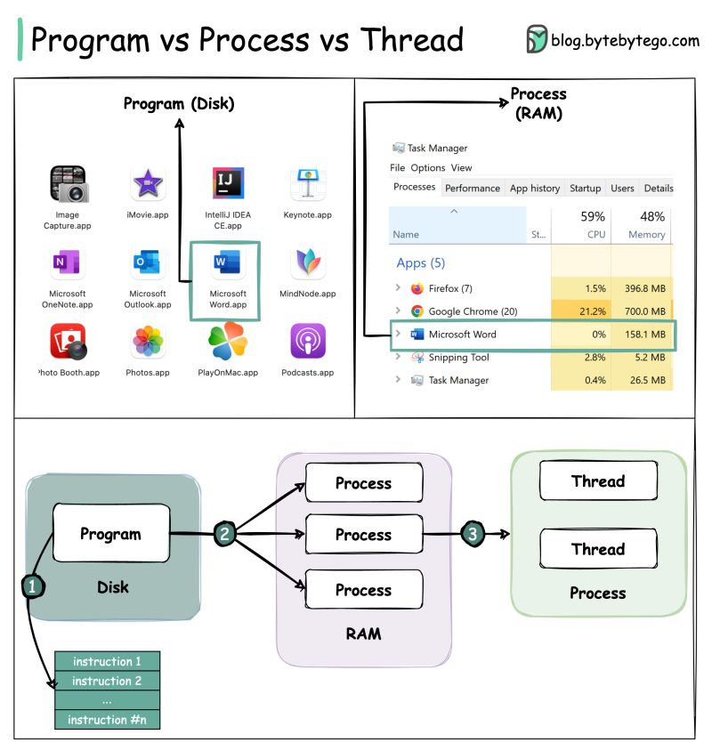
Concurrent Programming(/MultiThreading) in .NET(Core)
For Further Exploration –
Processes, Threads, AppDomains And Object Contexts | luke wickstead

Slide 50
Concurrent Programming(/MultiThreading) in .NET(Core)
 | When to Use | Comment(s)/Example(s)
Thread | When you need to control at the minutest level how these are managed(created, started, resumed, stopped etc.) | How to Pass Data Thread Function in Type-Safe Manner in C# How to Retrieve Data from a Thread Function in C# - Dot Net Tutorials
ThreadPool | Primarily used to reuse application threads and provide management of the worker threads. | Thread Pools - Win32 apps | Microsoft Learn (check/google/chaptGPT how data can be passed to [& back from] ThreadPool)
Task | Internally a Thread only but managed via the ThreadPool by default. | c# - What is the difference between task and thread? - Stack Overflow Task Class (System.Threading.Tasks) | Microsoft Learn (check/google/chatGPT how data can be passed to [& back from] Task)

Slide 51
Concurrent Programming(/MultiThreading) in .NET(Core)
Main Reason(s)/Advantages for MultiThreading –
1) Scalability using Worker Threads. Also, each thread can perform different/similar operation if needed.
Applications built using Thread Scalability –
a) Building High Performant Schedulers
b) Building High Performant servers in Client-Server model. Ultimately,
servers are continuously running schedulers listening for some network
protocol(s) based requests.
2) UI(/Client) Responsiveness(using async Threads)
3) Resource Sharing - but this can create problems also as depicted below
Shared Resource Concurrent Access Issues –
Unpredictable Values
Race Condition
Dead Lock

Slide 52
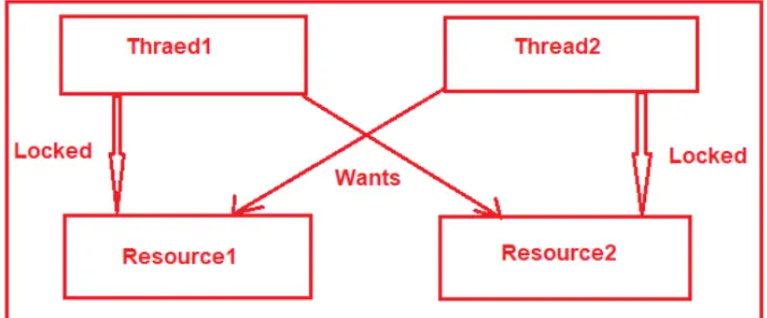
Concurrent Programming(/MultiThreading) in .NET(Core)
Race Condition –
A race condition happens when two or more threads want to update shared data at the same time.
What is a Race Condition? Vulnerability and Attack
Dead Lock –
Mainly happens when multiple threads are waiting for other threads to release some shared resource
EP112: What is a deadlock? - ByteByteGo Newsletter

Slide 53
Concurrent Programming(/MultiThreading) in .NET(Core)
Necessary Conditions for Dead Lock –
Mutual Exclusion: Resources involved must be unshareable between multiple threads.
Hold and Wait: Threads hold the resources they have allocated and wait for the resources they want.
No pre-emption: If the thread locks the resource, other threads cannot take the resource until the thread releases it.
Circular Wait: A circular chain must exist in which each thread waits for other threads to release resources.
Solving Shared Resource Concurrent Access Issues –
Using some critical section(some form of lock) wherein only some limited number of Thread(s)[typically 1] can enter at a time(& others will be queued up until their time comes to enter the critical section) & thus shared resource can’t be accessed concurrently by multiple threads at the same time & thus the issue gets resolved. This is a form of Synchronization.

Slide 54
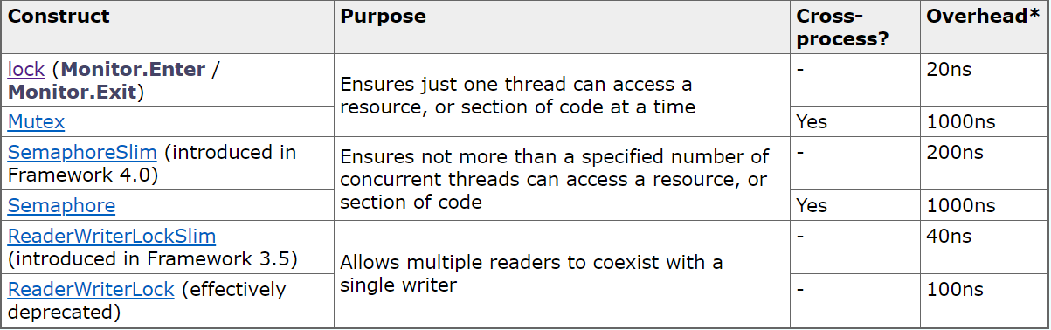
Concurrent Programming(/MultiThreading) in .NET(Core)
Synchronization –
Synchronization is particularly important when threads access the same data. Its basically coordinating the actions of threads for a predictable outcome.
Basic Blocking Methods -
Sleep, Join, Task.Wait etc are simple blocking methods that wait for other thread(s) to finish or for a period of time to elapse.
Locking constructs –

Slide 55
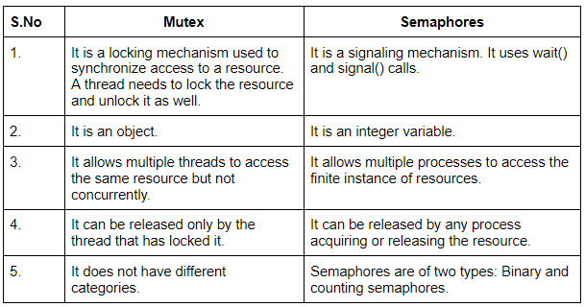
Concurrent Programming(/MultiThreading) in .NET(Core)
Synchronization –
A Cross-Process (Named) Mutex Example(e.g. 2 apps trying to access the same file) –
.net - Synchronization between two processes in C#.? - Stack Overflow
Using C# Mutexes for interprocess synchronization

Slide 56
Concurrent Programming(/MultiThreading) in .NET(Core)
Synchronization –
Choosing the Synchronization Object to Lock on –
lock(someNonStaticObject)
lock(someStaticObject)
lock(this)
lock(SomeType) – maybe using typeOf operator, get SomeType
Lock vs Monitor – Lock vs monitor in c#. Lock:- In C#, the lock keyword is used… | by Kamlesh Singh | Medium
Busy Waiting(/Spinning) –
When a thread blocks or unblocks, the operating system performs a context switch. This can be avoided using BusyWaiting. When a thread is in critical section, other threads simply spins(just loops) and keeps checking the break condition(via some flag) to enter in its critical section. This is called BUSY WAITING. Busy waiting wastes CPU cycles that some other process can use for doing any productive work. Mainly used for short span locks.

Slide 57
Concurrent Programming(/MultiThreading) in .NET(Core)
Synchronization –
XSlim Locks where X can be Semaphore, ReaderWriterLock –
XSlim represents a lightweight, fast construct that can be used for waiting when wait times are expected to be very short.
Async Awaiting inside C# Locks –
Async Waiting inside C# Locks. Infact, this technique is possible with most of the constructs deriving from System.Threading.WaitHandle.
Cancellation, Lazy Initialization &Thread Local Storage –
Threading in C# - Part 3 - Using Threads
How to use cancellation tokens in ASP.NET Core 7 | InfoWorld
For Web API, if the client is some Web UI or Non .NET 3rd party API, use a custom Middleware[or Filter] based on command(‘cancel’) pattern alongwith keeping track of the cancellation token per request(identifier passed by client) using some [distributed] cache.

Slide 58
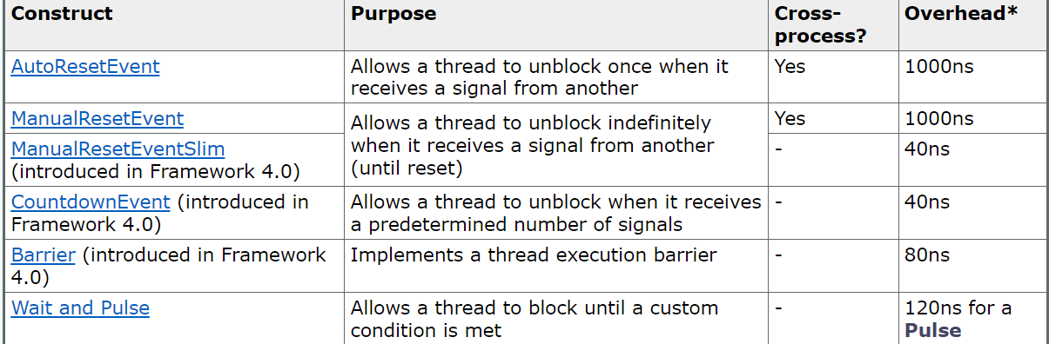
Concurrent Programming(/MultiThreading) in .NET(Core)
Synchronization –
Signaling Constructs - Signaling is when one thread waits until it receives notification from another. Event wait handles are the simplest of the signaling constructs and they are unrelated to C# events. Mainly needed for Thread(s) based Orchestration & most Orchestrations can be implemented using FSM(Finite State Machine) Techniques.

Slide 59
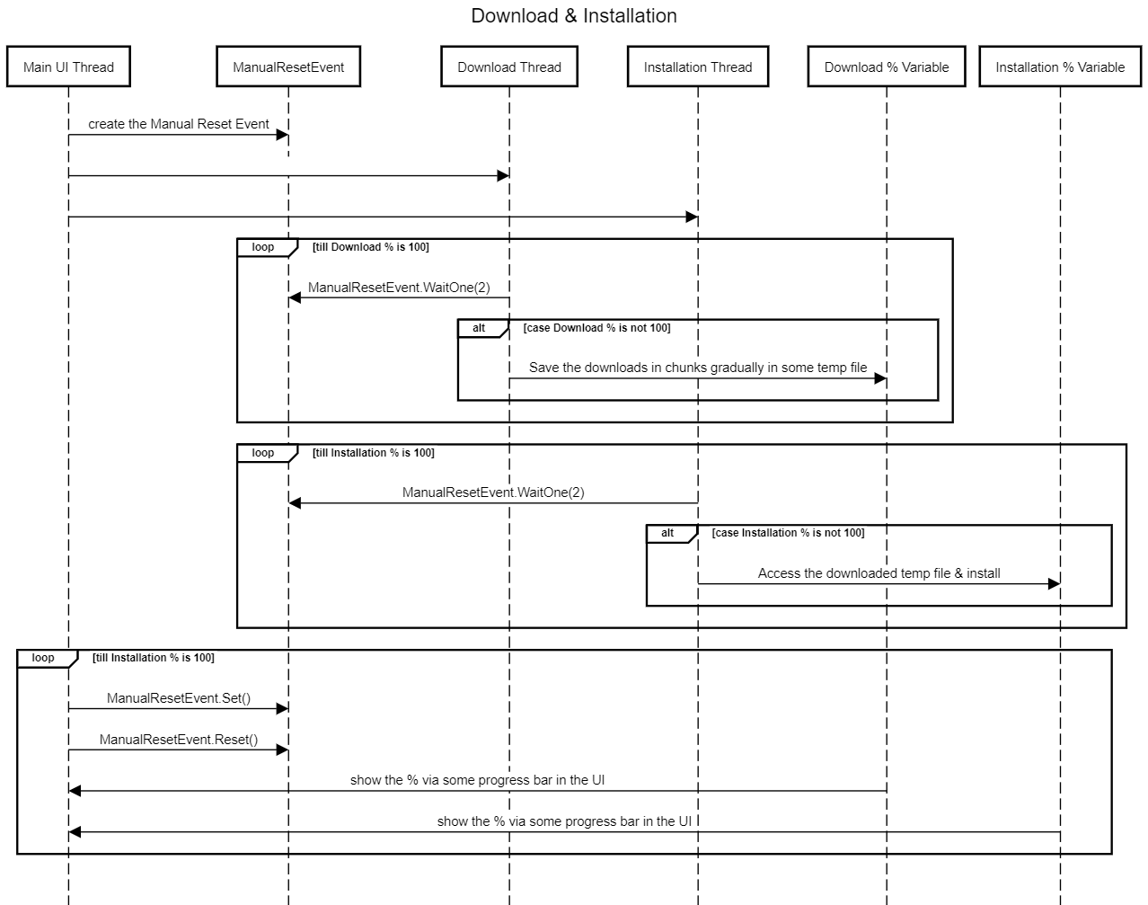
Concurrent Programming(/MultiThreading) in .NET(Core)
Synchronization –
Although ManualResetEvent can handle multiple threads but AutoResetEvent can handle only 1 thread at a time & so in the above case we would need 2 AutoResetEvents(1 for signaling between main & download thread while the other for signaling between main and installation thread)

Slide 60
Concurrent Programming(/MultiThreading) in .NET(Core)
Synchronization –
Advanced NonBlocking Constructs –
Atomic Operations – operations that cannot occur concurrently & should always occur in a sequence only(multithreading - What are atomic operations for newbies? - Stack Overflow)
Compare And Swap - c# - Locks vs Compare-and-swap - Stack Overflow
Lock Splitting vs Lock Stripping –
java - Lock splitting vs lock striping - Stack Overflow
For Further Exploration –
GitHub - PacktPublishing/MultithreadingwithCSharpCookbookSecondEdition_Code: Multithreading with C# Cookbook Second Edition
c# - Check the Number of threads available in ThreadPool at any time - Stack Overflow
GitHub - MikeMKH/concurrency-in-csharp-cookbook: Daily kata from Concurrency in C# Cookbook
GitHub - Wintellect/PowerThreading: Jeffrey Richter's Power Threading Library
Free Ebook - Web Servers Succinctly
2DGD_F0TH/chapters/001_Introduction/001_Introduction.md at master · 2DGD-F0TH/2DGD_F0TH · GitHub
GitHub - rikace/fConcBook: Source code for "Concurrency in .NET" book Manning publisher
Multithreading Principles and Patterns
Multithreading and Patterns - DEV Community
web.stanford.edu/class/archive/cs/cs110/cs110.1202/static/lectures/12-multithreading-patterns-data-structures.pdf
Common patterns for poorly-behaved multithreaded apps - Visual Studio (Windows) | Microsoft Learn
Part B (ADVANCE) Multithreading Design Patterns ( pthreads ) | Udemy
Embedded C Programming Design Patterns: Essential design patterns for clean, maintainable and robust firmware development. eBook : Schröder, Martin: Amazon.in: Books
GitHub - sundaygeek/design-patterns-for-embedded-system-in-c: <design-patterns-for-embedded-system-in-c>
Seven Concurrency Models in Seven Weeks: When Threads Unravel by Paul Butcher
List of concurrency models - Stack Overflow

Slide 61
Multi Core Parallel Programming in .NET(Core)
Assigning a Thread to a specific core –
c# - How can I set processor affinity to a thread or a Task in .NET? - Stack Overflow
MultiCore_Locking_constructs– Threading in C# - Part 5 - Parallel Programming
Some usual Parallel constructs –
Parallel.Invoke – equivalent to Task.WhenAll but in this case threads are optimally distributed across multiple cores.. For Speculative Execution, there is no Parallel equivalent but you need to use Task.WhenAny but for this if you want to use multiple cores optimally, you will have to build some wrapper over Task.WhenAny using the above 2 links/resources(Processor Affinity based Thread [& SpinWait]). For Sequential API calls better to use Task.ContinueWith for better readability.
Parallel.For
Parallel.ForEach
Parallel Constructs can be used to fire calls to multiple APIs or DB Tables or any external resource for single or multiple(Bulk/Batch) items in each API or DB or some other external call.
Threading in C# - Part 5 - Parallel Programming
Plinq –
AsParallel is applicable only on IEnumerable and not IQueryable.
Threading in C# - Part 5 - Parallel Programming

Slide 62
Multi Core Parallel Programming in .NET(Core)
ConcurrentCollections –
Threading in C# - Part 5 - Parallel Programming
Immutable Collections vs Concurrent Collections –
c# - When immutable collections are preferable than concurrent - Stack Overflow
For Further Exploration(a bit advanced)–
GitHub - PacktPublishing/Hands-On-Parallel-Programming-with-C-8-and-.NET-Core-3
GitHub - PacktPublishing/Parallel-Programming-and-Concurrency-with-C-sharp-10-and-.NET-6
c# - How do I spawn threads on different CPU cores? - Stack Overflow
c# - Can you force Parallel.Invoke to use multiple threads? - Stack Overflow
c# - How to set maximum concurrent threads using Task - Stack Overflow
Limiting concurrency for faster and more responsive apps - Developer Support
c# - Limited concurrency TaskScheduler that can interleave tasks to be explicitly ordered - Stack Overflow
A Tour of ParallelExtensionsExtras - .NET Parallel Programming
GitHub - ChadBurggraf/parallel-extensions-extras
For Further Reading (Parallel Programming) - .NET | Microsoft Learn
GitHub - rikace/parallel-patterns
Patterns for Parallel Programming[Book]
Build Your Own RealTime OS (RTOS) From Ground Up™ on ARM 1 | Udemy
Build Your Own RealTime OS (RTOS) From Ground Up™ on ARM 2 | Udemy
"DIY RTOS Made Easy: Mastering Microcontrollers " | Udemy

Slide 63
Async/Await
Advantages -
1) Better IO Performance
2) Thread Reusability
3) Thread Scalability
Async Programming Best Practices -
Async/Await - Best Practices in Asynchronous Programming | Microsoft Learn
Patterns & Practices for efficiently handling C# async/await cancel processing and timeouts | by Yoshifumi Kawai | Medium
Asynchronous Patterns -
Asynchronous programming patterns - .NET | Microsoft Learn
Custom Awaitables -
await anything; - .NET Parallel Programming
For Further Exploration -
Async in C# 5.0[Book]
Parallel.ForEachAsync() and Task.Run() With When.All in C# - Code Maze

Slide 64
Stream Programming
Why/When do you need Stream(s) –
Say you want to transfer a large file array/list/object from one server to another but your intermediate server(which will get the data from source & process it & then transfer & store to destination) has RAM(/memory) limitations & the large array/list/file/object needs to be processed & so only option left is to then divide the large array/list/file/object into chunks & then it can be a stream of chunks which is in general easier to be processed. The chunk in general is in the form of byte(s) & can be a single byte or a block of byte(s)(although chunks can be some text[character or string], XML, JSON etc as well).Streaming is a real good technique to solve such problems.
Also, sometimes Streaming improves the overall performance of a system.

Slide 65
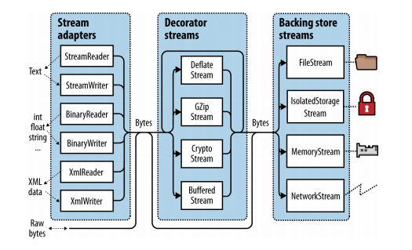
Stream Programming
.NET Streaming Architecture
N.B. – Although the arrows (direction) above might give the impression that the data is always moving from Stream Adapters to Decorator Streams to Backing Stores but that’s in the case of writing data from RAM (using some class inheriting from StreamWriter class or the StreamWriter class itself which again inherits from Stream class). For reading data into the RAM, it’s the other way around.(using some class inheriting from StreamReader class or the SreamReader class itself which again inherits from Stream class).

Slide 66
Stream Programming
.NET Streaming Architecture contd…
High Level Stream(s) Type/Group | Description
Backing Store Stream(s) | Hardwired to a particular type of Backing Store. Provides raw data. Itself a Stream.
Decorator Stream(s) | Feed off another stream & transform the data in some way (compression or encryption or Buffering). Chain of decorators also possible. Itself a Stream.
Adapter Stream(s) | Both Backing store & Decorator stream deal exclusively in bytes. Although that's flexible & efficient but an app often works at higher levels like formatted bytes or text(character or string) or XML or JSON etc. Adapters bridge this gap by wrapping a stream in a class with specialized methods types to a particular format. Itself is not a Stream.
N.B. – To compose a chain, you simply pass one object into another’s constructor.

Slide 67
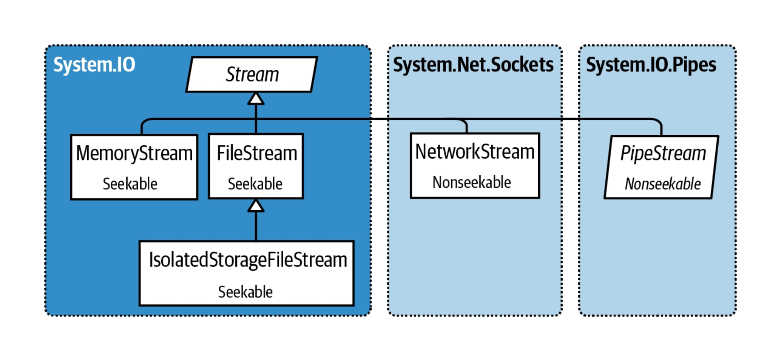
Stream Programming
Backing Store Stream(s)
For Further Exploration(Seek & Peek) -
c# - Stream.Seek(0, SeekOrigin.Begin) or Position = 0 - Stack Overflow
StreamReader.Peek Method (System.IO) | Microsoft Learn

Slide 68
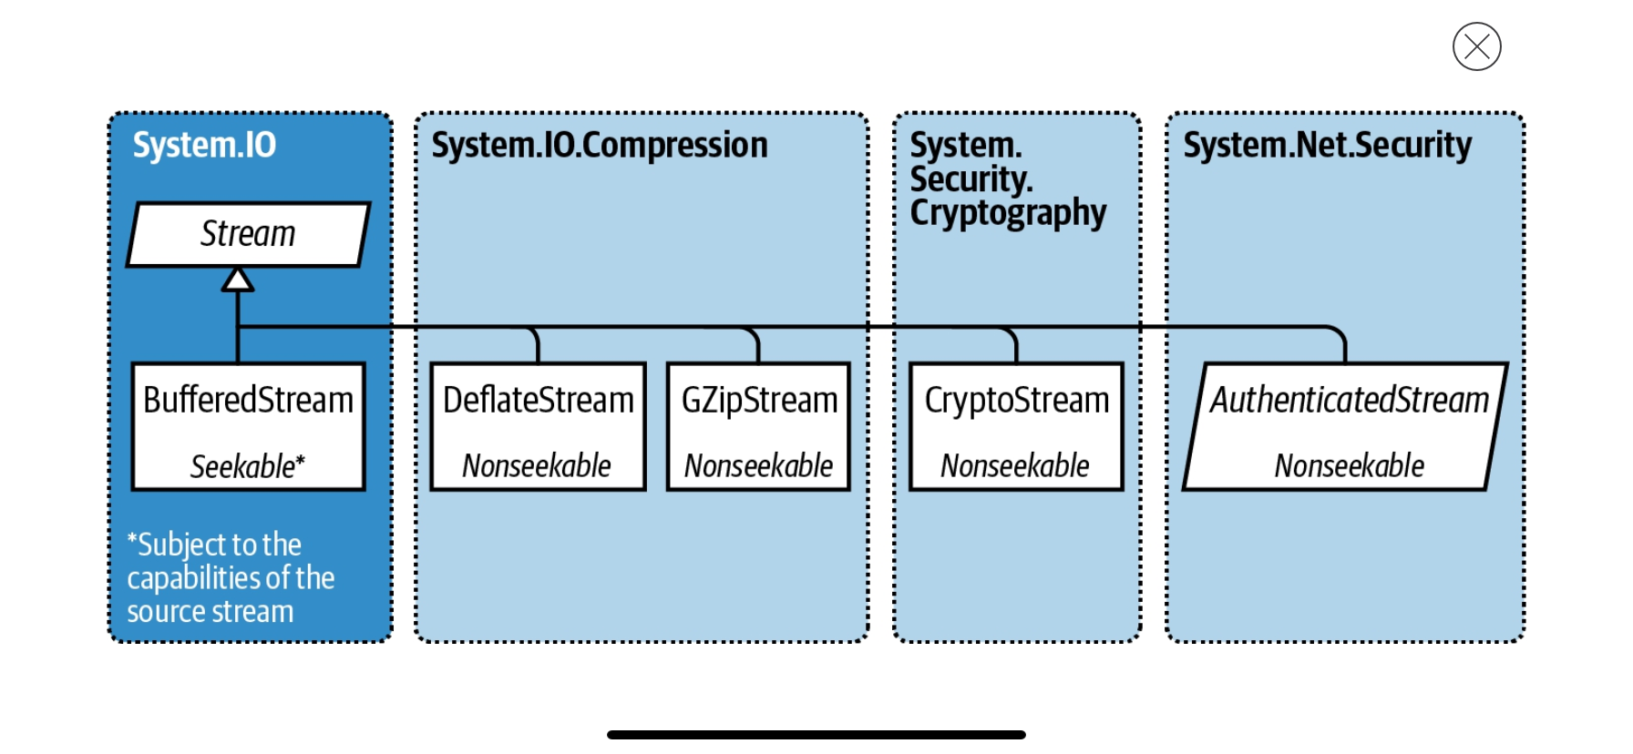
Stream Programming
Decorator Stream(s)
For Further Exploration –
Anonymous Pipes Made Easy- CodeProject

Slide 69
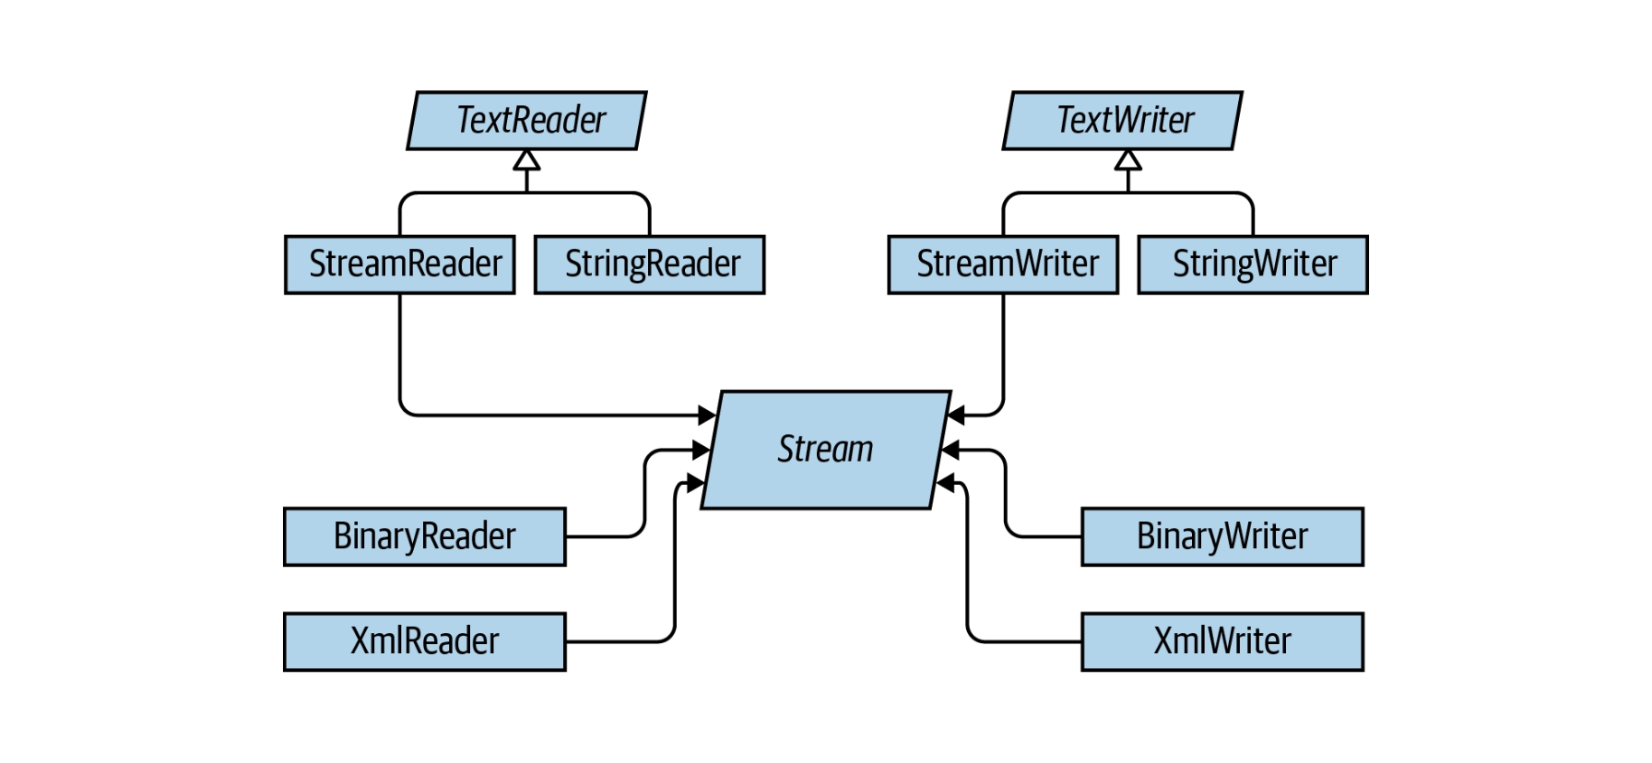
Stream Programming
Stream Adapter(s)

Slide 70
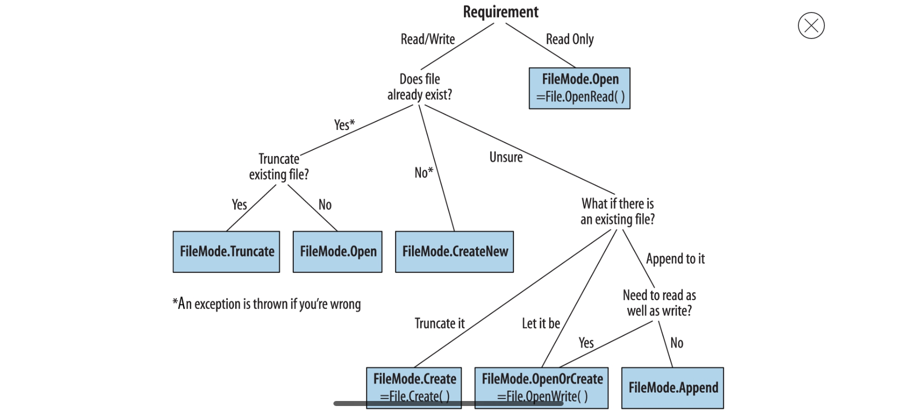
Stream Programming
File(/Directory) Operations
For Further Exploration –
Reading large text files with streams in C# - Stack Overflow
System.IO Namespace | Microsoft Learn
Environment.SpecialFolder Enum (System) | Microsoft Learn
Memory-Mapped Files - .NET | Microsoft Learn

Slide 71
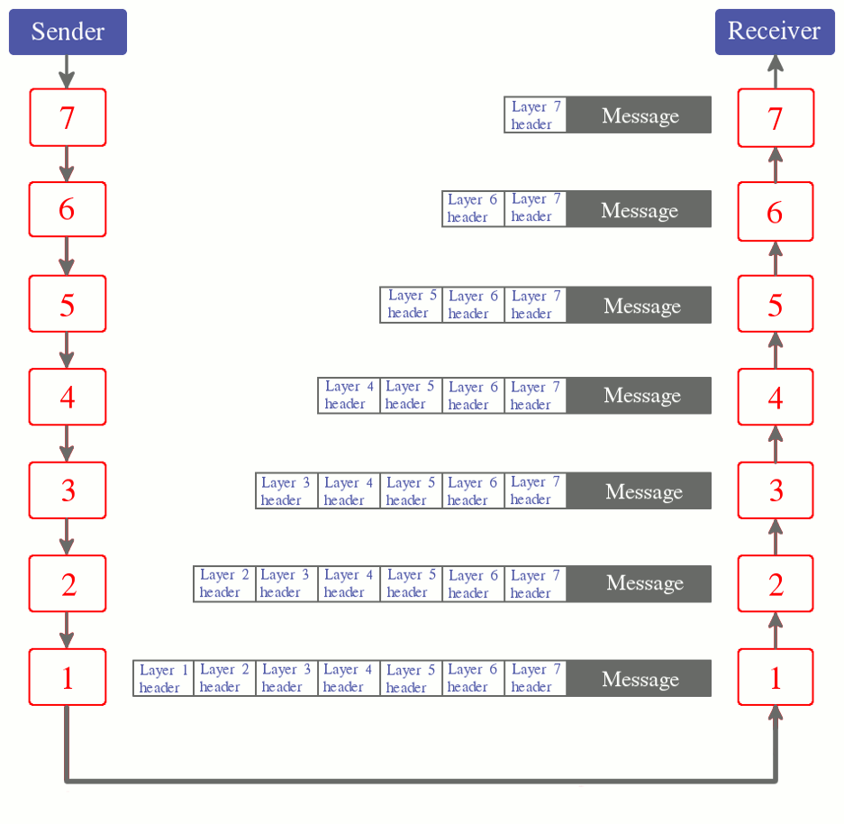
Network Programming
OSI Model
For Further Exploration –
In the OSI layers, in what format would the data or message be in each layer? - Quora

Slide 72
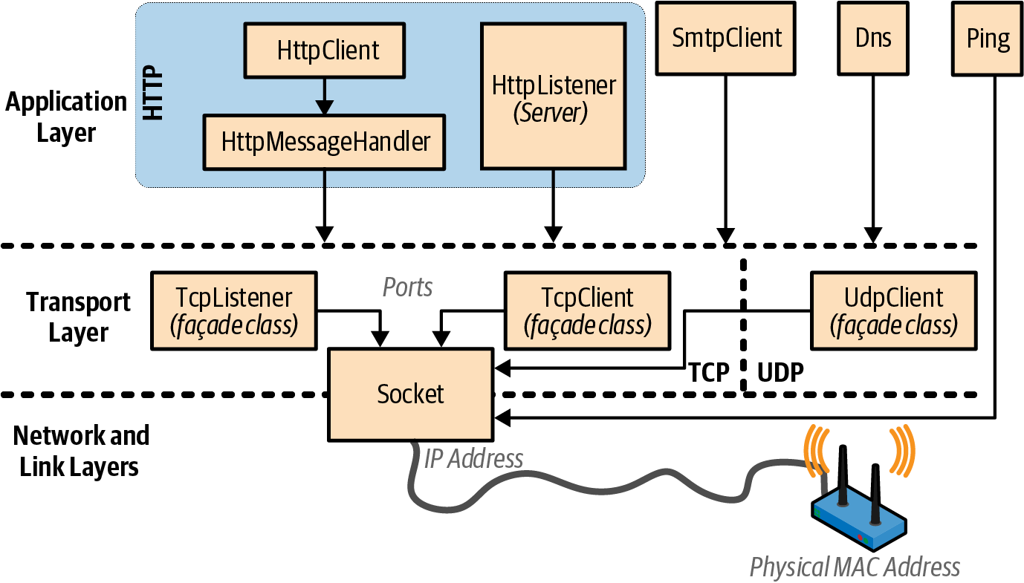
Network Programming
.NET Network Architecture
For Further Exploration –
HTTP1 vs HTTP2 vs HTTP3 - A Deep Dive
TCP vs UDP | LinkedIn
Reliable User Datagram Protocol – Wikipedia
sockets - What do you use when you need reliable UDP? - Stack Overflow
GitHub - VasanthVanan/computer-networking-top-down-approach-notes
GitHub - PacktPublishing/Hands-On-Network-Programming-with-CSharp-and-.NET-Core
Network programming in .NET - .NET | Microsoft Learn
High Performance Browser Networking (O'Reilly)
What Is Checksum? Guide to Learn Checksum | Simplilearn
debugging - Wireshark vs Firebug vs Fiddler - pros and cons? - Stack Overflow

Slide 73
Meta-Programming
Reflection is just a way of investigating(/invoking) objects during run-time
Ways to access Type Object in .NET -
SomeClassInstance.GetType()
typeof(SomeClass)
Assembly.GetType(“SomeClass”)
Type.GetType(“SomeClass”)
Reflection Overview –
Reflection Overview | Microsoft Learn
Some Reflection Use Cases –
To execute a private member(/get/set) of the class
Determining dependencies of an assembly
Location types which conform to an interface, derive from a base / abstract class, and searching for members by attributes
Building Unit Testing, Mocking & BDD Frameworks
Building Code Analysis Tools
Building AoP Frameworks

Slide 74
Meta-Programming
Code Generation Usage –
Create a class from scratch at runtime
IL Rewriting(e.g. add[/modify] a member to[/of] class)
Code Generation Techniques in C# –
T4 Template
CodeDom
Reflection.Emit
ExpressionTree
Roslyn API/Source Generators
Code Snippets

Slide 75
Meta-Programming
Code Generation Techniques Comparison –
Code Generation Technology-CodeDom VS T4
c# - Reflection.Emit vs CodeDOM - Stack Overflow
Using Roslyn for Runtime Code Generation in Marten – The Shade Tree Developer
T4 Template –
T4 (Text Template Transformation Toolkit) Code Generation - Best Kept Visual Studio Secret - Scott Hanselman's Blog
Free Ebook - T4 Succinctly
CodeDom –
CodeDOM Go Kit: The CodeDOM is Dead, Long Live the CodeDOM- CodeProject
Reflection.Emit –
DOT NET TRICKS: DLR using Reflection.Emit (In Depth) Part 2
ExpressionTree–
Dynamic Code Generation in C# With Expression Trees | by Bagoum | Medium

Slide 76
Meta-Programming
Roslyn API/ Source Generators–
Incremental Roslyn Source Generators In .NET 6: Code Sharing Of The Future - Part 1 - Thinktecture AG
Source Generators in C#
Deep dive into Source Generators | TheCodeMan
The .NET Compiler Platform SDK (Roslyn APIs) - C# | Microsoft Learn
Free Ebook - Roslyn Succinctly
Code Snippets(more used as VS Plugin rather than for Application) –
How to Automatically Generate C# Code Snippets in Visual Studio
Code Generation Performance Improvement –
Mainly done via some In-Memory Caching
By the way, Automapper is a pretty cool library w.r.t object mapping, which is build using mainly Reflection. Refer Mastering AutoMapper in C#: A Comprehensive Guide - ByteHide & c# - Automapper. Map if source member is null - Stack Overflow for further details around the same.
For Further Exploration –
ProgramGeneration_Trennung.PDF

Slide 77
Meta-Programming
var vs dynamic –
var says “Let the compiler figure out the type”
dynamic says “Let the runtime figure out the type”
Late Binding And Doing That using Reflection –
Early vs Late Binding, reflection, and type dynamic in C#
Simplifying Late Binding Using dynamic –
Understanding Late Binding: Dynamic Objects and Reflection in C# .NET | LinkedIn

Slide 78
Meta-Programming
Simplifying Visitor Pattern Using dynamic –
In essence, the Visitor pattern allows you to “add” a method to a class hierarchy/graph without altering existing classes. But it also requires that visited classes be made visitor-friendly by exposing an Accept method, which can be impossible if the classes are not under your control. With dynamic pattern you can achieve the same goal & without needing to modify existing classes.
The Visitor Pattern and dynamic in C# 4 — Faithlife Code Blog
N.B. – From performance perspective, Mixins are better way to implement visitor pattern than using the dynamic pattern.
ExpandoObject vs DynamicObject–
c# - Differences between ExpandoObject, DynamicObject and dynamic - Stack Overflow

Slide 79
Assemblies
GAC & Strong Naming –
c# - Why use strong named assemblies? - Stack Overflow
Assembly Loading Order–
.net - In what order are locations searched to load referenced DLLs? - Stack Overflow
c# - .NET use application config file to load an assembly that is referenced by another assembly - Stack Overflow
Satellite Assembly–
.net - What is a satellite assembly? - Stack Overflow

Slide 80
AoP(Aspect Oriented Programming)
Doing AoP using Attributes in .NET –
jot.fm/issues/issue_2007_03/article1/
Compile -Time Weaving Techniques in .NET –
MSIL Rewriting – PostSharp Technologies
Run -Time Weaving Techniques in .NET –
Middleware and Dependency Injection – PostSharp Technologies
A Generic Example Using MS Unity –
DDD-Based-Enterprise-Application-Framework/Infrastructure/AoP at master · sandipray63in/DDD-Based-Enterprise-Application-Framework · GitHub
For Further Exploration –
Aspect-Oriented Programming (AOP) - Microsoft Unity Succinctly Ebook

Slide 81
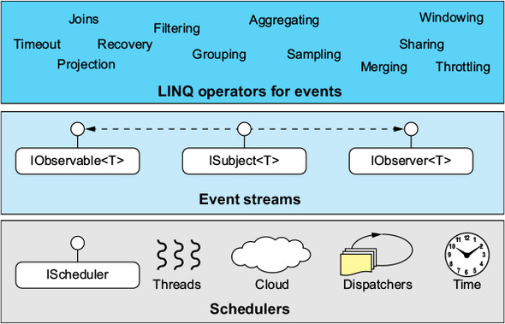
Reactive Programming(Rx.NET)
Some High Level Examples –
Rx.NET in the real world. Lessons that can help you when marbles… | by William Barbosa | Medium (supports collections as well as hierarchies)
For Further Exploration –
SignalR + RX (Streaming Data Demo App 1 of 2)- CodeProject

Slide 82
SOLID Principles
Intro to SOLID Principles –
A Solid Guide to SOLID Principles | Baeldung
Some concepts related to SOLID–
D of SOLID is Dependency Inversion & Not Dependency Injection
OCP & Extension Methods
Liskuv Substitution and various types of Abstractions in .NET(next slide)
Interface Seggregation Principle & Microservices

Slide 83
SOLID Principles
Abstractions in .NET & Liskuv Substitution Principle–
Abstractions in .NET -
Abstract (Parent) Class
Interface
Generics –
Abstract Generic (Parent) Class
Generic Interface
Delegates –
(Generic) Action
(Generic) Func
Although Non-Abstract (Generic) Parent Class is not an abstraction in the true sense but can be used as polymorphic constructs of Liskuv Substitution principle
For Further Exploration –
Pros & Cons of SOLID Principles | LinkedIn
Free Ebook - SOLID Principles Succinctly

Slide 84
IoC/DI
.NET Core DI Techniques
why do we have setter & function based DI?
.NET Core DI Lifecycle Management
Scoped – Per Scope(scope for example can be http request).
Transient - New instance created each time it’s requested.
Singleton – Single Instance Per App(Domain)
Is DI the same as IoC?
Inversion of Control vs Dependency Injection - Stack Overflow
To or Not to DI?
To or Not To DI | LinkedIn

Slide 85
Design Patterns – Creational Patterns
Pattern Name | When to Use | Example(s)
Factory | Based on some key you need to create an object which can implement some Abstraction. Generally other Patterns like Strategy, State, Template Method etc uses this pattern. | WeatherForecastAzureFunctionAndAngularSample/WeatherForecastAPI/DomainServices at master · sandipray63in/WeatherForecastAzureFunctionAndAngularSample · GitHub
Builder | When a complex object needs to be build in steps. | Refactoring Guru|Builder Pattern
Singleton | When you just need one & only one instance. | DDD-Based-Enterprise-Application-Framework/Infrastructure/DI/Container.cs at master · sandipray63in/DDD-Based-Enterprise-Application-Framework · GitHub
Multiton | When you need some fixed number of limited instances only[but each created only once] | Multiton pattern - Wikipedia
Prototype | When you don’t want to touch an existing instance but you need a replica to perform some operations. Basically, its Cloning. | Prototype pattern - Wikipedia
Abstract Factory | When you need a factory of factories, use this pattern(maybe using some composite key if needed) | Abstract factory pattern - Wikipedia
Lazy Initialization | Initialize an instance only when required | Lazy initialization - Wikipedia
Object Pool | When you have CPU/IO intensive resources(e.g. threads, connection objects etc) build a pool of such objects & (re)use them as & when required based on demand | Object pool pattern - Wikipedia

Slide 86
Design Patterns – Structural Patterns
Pattern Name | When to Use | Example(s)
Adapter | When you want to adapt your functionality to some external functionality | Adapter pattern - Wikipedia
Bridge | When you have varying abstractions as well as varying implementations. | Refactoring Guru | Bridge Pattern DDD-Based-Enterprise-Application-Framework/Repository/Base/IQueryableRepository.cs at master · sandipray63in/DDD-Based-Enterprise-Application-Framework · GitHub Varying abstractions can be implemented using generic abstractions
Composite | Compose/build complex trees(/graphs) | Refactoring Guru | Composite Pattern
Decorator | To provide pre/post processing functionalities to the main functionality. | Decorator pattern - Wikipedia
Flyweight | Use sharing to support large numbers of similar objects efficiently. Basically, it’s Caching. | Flyweight pattern - Wikipedia What is the reason for the name of the Flyweight Design Pattern? - Stack Overflow
Facade | Provide a unified interface to a set of interfaces in a subsystem. Facade defines a higher-level interface that makes the subsystem easier to use. | Facade pattern - Wikipedia
Proxy | Provide a surrogate or placeholder for another object to control access to it e.g. SOAP Based Web Services proxy | Proxy pattern - Wikipedia

Slide 87
Design Patterns – Behavioural Patterns
Pattern Name | When to use | Example(s)
Chain of Responsibility | Avoid coupling the sender of a request to its receiver by giving more than one object a chance to handle the request. Chain the receiving objects and pass the request along the chain until an object handles it. Allow multiple handlers in sequence to handle the responsibilities. Fluent APIs are one way of doing the same. | Chain-of-responsibility pattern – Wikipedia Chain Responsibility Pattern | TheCodeMan
Command | Encapsulate a request as an object, thereby allowing for the parameterization of clients with different requests, and the queuing or logging of requests. It also allows for the support of undo-able operations. | RefatoringGuru | Command Pattern
Interpreter | Given a language, define a representation for its grammar along with an interpreter that uses the representation to interpret sentences in the language. Helpful in building DSLs(Domain Specific Languages) | Interpreter pattern - Wikipedia
Iterator | Provide a way to access the elements of an aggregate object sequentially without exposing its underlying representation. | DDD-Based-Enterprise-Application-Framework/ApplicationAndInfrastructureServices/BatchProcessing/BaseBatchSeedSelector.cs at master · sandipray63in/DDD-Based-Enterprise-Application-Framework · GitHub Multi-Threading based Iterator?

Slide 88
Design Patterns – Behavioural Patterns contd…
Pattern Name | When to use | Example(s)
Mediator | (In-Memory) Model for route-handling of multiple requests and responses between producers and consumers | Refactoring Guru|Mediator Pattern CQRS Pattern With MediatR
Memento | Without violating encapsulation, capture and externalize an object's internal state allowing the object to be restored to this state later. Mainly useful in building Undo/Redo Operations. | Refactoring Guru|Memento Pattern
Observer | Define a one-to-many dependency between objects where a state change in one object results in all its dependents being notified and updated automatically. | Refactoring Guru | Observer DDD-Based-Enterprise-Application-Framework/Infrastructure/Observers at master · sandipray63in/DDD-Based-Enterprise-Application-Framework · GitHub SignalR + RX (Streaming Data Demo App 1 of 2)- CodeProject
State | Allow an object to alter its behavior when its internal state changes. The object will appear to change its class. | Refactoring Guru | State Pattern Type Driven Development Permissible States Rules Engine Graph concepts and state machine Domain-Specific Languages: An Introductory Example | 1.1 Gothic Security | InformIT Embedded System Design using UML State Machines | Udemy
Strategy | Define a family of algorithms, encapsulate each one, and make them interchangeable. Strategy lets the algorithm vary independently from clients that use it. | Strategy pattern – Wikipedia Book Review: Software Architecture, by Juval Lowy | LinkedIn

Slide 89
Design Patterns – Behavioural Patterns contd…
Pattern Name | When to use | Example(s)
Template Method | Define the skeleton of an algorithm in an operation, deferring some steps to subclasses. Template method lets subclasses redefine certain steps of an algorithm without changing the algorithm's structure. | Template method pattern - Wikipedia
Visitor | Visitor lets a new operation be defined without changing the classes of the elements on which it operates. Also, can be useful in traversing trees(pre-order, in-order or post-order). N.B. -> From ease of Extensibility perspective, Mixins are a better way to implement visitor pattern | Refactoring Guru | Visitor Pattern
For Further Exploration –
Software design pattern - Wikipedia
Refactoring Guru | Design Patterns
Dinesh Variyani’s Design Patterns Post | LinkedIn

Slide 90
.NET Core Middlewares(& Equivalents in earlier .NET Framweorks)
In today’s Cloud enabled world, most things implemented using middleware should ideally be implemented using API Gateway (following the “Fail Fast” principle). But sometimes the requirements are pretty complex & due to some technical constraints of the API Gateway(or it might not be contextually correct to put a API Gateway before some layer e.g. gRPC layer) we should not use API Gateway & in such cases its better to go with middlewares.
ASP.NET Core MiddleWares
ASP.NET Core Middleware | Microsoft Learn
gRPC Interceptors in .NET
gRPC interceptors on .NET | Microsoft Learn
ASP.NET Web API Pipeline and Extensibility
Web API_revised2

Slide 91
.NET Core Middlewares(& Equivalents in earlier .NET Framweorks)
WCF(/WWF Services) Extensibility
Carlos Figueira Explains WCF Extensibility - InfoQ
DDD-Based-Enterprise-Application-Framework/Infrastructure/WCFExtensibility at master · sandipray63in/DDD-Based-Enterprise-Application-Framework · GitHub
ASP.NET Http(/ Web Services) Interceptors(Handlers & Modules)
asp.net - HTTP handler vs HTTP module - Stack Overflow
The Two Interceptors: HttpModule and HttpHandlers- CodeProject

Slide 92
Plugins Development in .NET(Core)
Plugins in .NET Core(using AssemblyLoadContext)
Understand Advanced AssemblyLoadContext with C# | by Tsuyoshi Ushio | Medium
Also, AssemblyLoadContext actually replaces .NET Framework AppDomains in .NET Core & similarly now static variables are per AssemblyLoadContext
c# - Replacing .NET AppDomains with AssemblyLoadContexts - Stack Overflow
c# - Does AssemblyLoadContext isolate static variables? - Stack Overflow
Developing Plugins in .NET(Core) Framework using MEF[Managed Extensibility Framework]
From Zero to Proficient with MEF- CodeProject
Anuraj - Using MEF in .NET Core

Slide 93
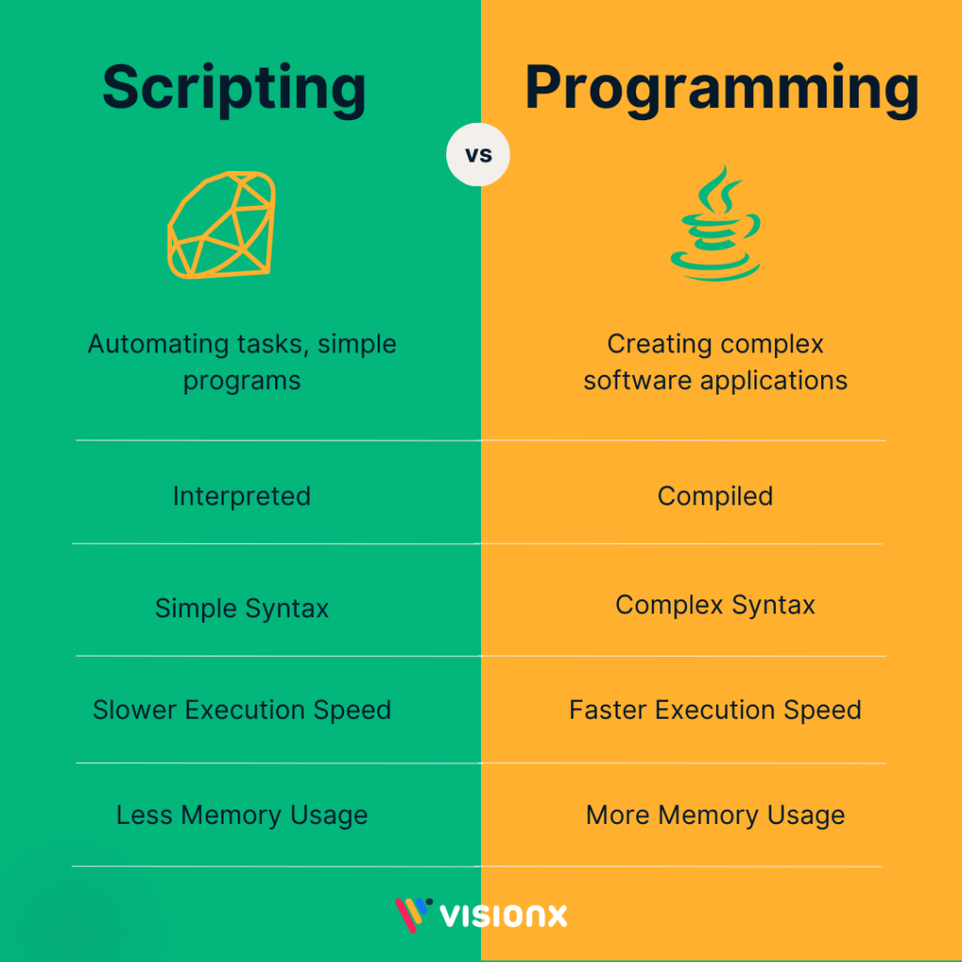
DSLs(Domain Specific Languages) -
A domain-specific language is somewhere between a tiny programming language and a scripting language, and is often used in a way analogous to a programming library

Slide 94
Domain Specific Languages -
DSL Types
Internal | External | Language Workbench
Host Language Grammar, Syntax & Parser | A separate Language | Language tools used to develop custom languages
e.g. LINQ, Fluent API Previous project discussion | e.g. – var mathEvaluator = new MathEvaluator(); var evaluatedValue = mathEvaluator.Evaluate(“1+2 + 3 + 3 * (8-6)”) ; Docker file | Language workbench - Wikipedia
An External DSL Example –
GitHub - sandipray63in/MerchantsGuideToGalaxy: Merchant's Guide to Galaxy Solution
For Further Exploration -
How does graphQL work anyway?. Understand how graphQL query execution… | by Rajesh Babu | Medium

Slide 95
Some Important Design Time NFRs(Non Functional Requirements)
Reusability (Nuget Private Repos following Cohesion & Coupling principles - Free Ebook - NuGet In-House Succinctly)
Maintainability
Extensibility
Reliability

Slide 96
Coding & Low Level Design Katas & Beyond
Category:Programming Tasks - Rosetta Code
GitHub - gamontal/awesome-katas: A curated list of code katas
Coding Challenges | John Crickett | Substack
Clean Code Cheat Sheet – planetgeek.ch
GitHub - ashishps1/awesome-low-level-design: Learn Low Level Design (LLD) and prepare for interviews using free resources.
GitHub - prasadgujar/low-level-design-primer: Dedicated Resources for the Low-Level System Design. Learn how to design and implement large-scale systems. Prep for the system design interview.
C# in a Nutshell
GitHub - markjprice/apps-services-net8: Repository for the Packt Publishing book titled "Apps and Services with .NET 8" by Mark J. Price
GitHub - markjprice/cs12dotnet8: Repository for the Packt Publishing book titled "C# 12 and .NET 8 - Modern Cross-Platform Development Fundamentals" by Mark J. Price
C# | Version History – GeeksforGeeks
What's new in C# 13 | Microsoft Learn
c# - how do I chunk an enumerable? - Stack Overflow
How To Write Elegant Code with C# Switch Expressions
Declare and use C# primary constructors in classes and structs | Microsoft Learn
Deconstructing tuples and other types - C# | Microsoft Learn
asynchronous - Why would one use Task<T> over ValueTask<T> in C#? - Stack Overflow
C# — Optimize Performance with Span and Memory | by Keyur Ramoliya | Medium
C# Interview Questions | LinkedIn
GitHub - miholler/NSpecifications: Specification Pattern for .Net
c# - Specification Pattern vs (Fluent) Validation - Stack Overflow
Creating a .NET Cron Job for Kubernetes | benbrougher.tech
The Ultimate Kubernetes CronJob Guide
Must Know Data Structures | LinkedIn
Data Structures and Algorithms Roadmap
Coding Interview Patterns LinkedIn
Coding Problems Patterns | LinkedIn
GitHub - ashishps1/awesome-leetcode-resources: Awesome LeetCode resources to learn Data Structures and Algorithms and prepare for Coding Interviews.
Technical Interview Guide for Busy Engineers | Tech Interview Handbook
GitHub - PacktPublishing/Systems-Programming-with-C-Sharp-and-.NET: , published by Packt
Native interoperability - .NET | Microsoft Learn
GitHub - ziishaned/learn-regex: Learn regex the easy way
Free Programming Books – GoalKicker.com
Regular Expressions Cookbook, 2nd Edition[Book]
GitHub - PacktPublishing/High-Performance-Programming-in-C-Sharp-and-.NET
GitHub - milanm/DotNet-Developer-Roadmap: The comprehensive .NET Developer Roadmap by seniority level.
Postgre Sql Query Execution Flow| LinkedIn
Free Postgres SQL Internals Book
GATE CS Notes (According to GATE 2025 Syllabus) – GeeksforGeeks
Computer Science Roadmap: Curriculum for the self taught developer
GitHub - jwasham/coding-interview-university: A complete computer science study plan to become a software engineer.
Make a Web Browser: Beginner's Guide
Web Browser Engineering
c# - Replacing .NET WebBrowser control with a better browser, like Chrome? - Stack Overflow
Build Your Own X

Slide 97
Topics Not Covered
COM InterOperability - fetch as much data as possible from COM into RAM (memory) & then do further processing .If needed use chunking.This is needed mainly to improve performance since COM calls are pretty slow.
NodeJs - by default async & only partly STA[Single Threaded Application] – mainly used in IO intensive apps & not much suitable for Compute[/CPU] intensive apps.
Python – check, List Comprehension & Numpy Multi-Dimensional Array.
Java - doesn’t have Exception Bubbling & async-await by default). But I love 1 thing in Java compared to .NET & that’s that Java has only one generic argument equivalent of Action<T> & Func<T> while .NET has Action<T1>/Func<T1> till Action<T1, T2,…….T16>/Func<T1,T2,……T16.>. Although Action<T>/Func<T>/Action<T1>/Func<T1> should suffice but not sure why the .NET Language Designers opted to support till T16 (although tomorrow I may need T17 or more & all such T1 till T16 or more can be wrapped into a single “T” class as properties & then processed further .
C++ - One might think that C++ is now obsolete but its still used like anything, for real high performance code[e.g. Financial Risk modelling] or Embedded Systems[in IoT{Internet of Things}, the “Things” are in general some nominal or full fledged Embedded Systems.), A good free C++ reference for .NET Developers is Free Ebook - C++ Succinctly

Slide 98
Thank You

